Slide 1


Slide 2

Intro To Git and GitHub
Tyrone Wong
@Ty-Won
Honorary Mention: Ovflowd for the slide design
Notes:
What are you about?

Slide 3


Hey there!
Welcome to the first workshop of the semester!

Slide 4


Before we launch
Git Installed
GitHub Account
Your favorite coding env

Slide 5


Slide 6

workshop outline

Slide 7




My first git: What is Git and GitHub?
git good: Git Fundamentals 101
git explore: Explore the GitHub Universe
open sourcing: Doing some good for the tech community

Slide 8

My first Repo
Create your first GitHub repository and your first commit.

Slide 9


Wait, what is GitHub and Git?

Slide 10

What is a Git?
A Distributed version control system!
Any project using git will have a ".git" folder that stores the history of the project

Slide 11



history:
Know exactly which files changed, who made those changes, and when those changes occured.
backup:
Ability to have different versions of the code in different places.
collaboration:
Collaborate easily with other people on the same project by uploading and receiving changes

Slide 12

What is GitHub?
GitHub is a website that allows you to use Git and create repositories online !

Slide 13
What is a repository?
A repository is a container that houses your project and its’ history. If your project folder contains the “.git” folder you’re working with a repository!

Slide 14
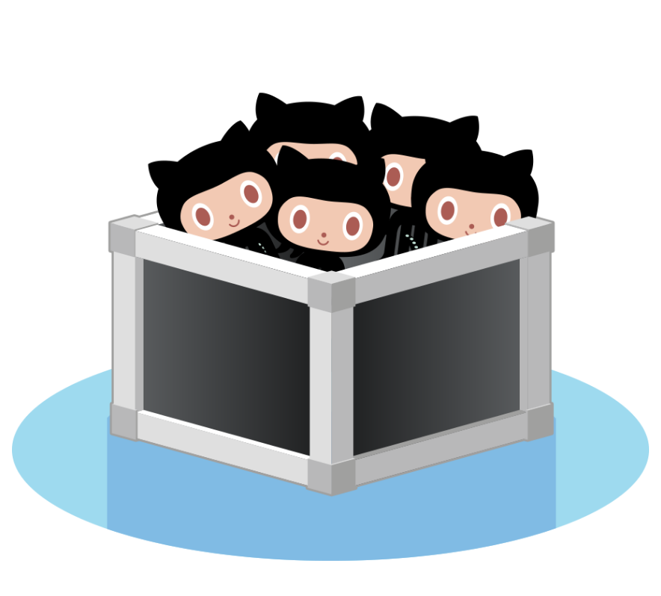
Repositories can be local and remote!
Your local project files on your computer
Your remote project files elsewhere

Slide 15
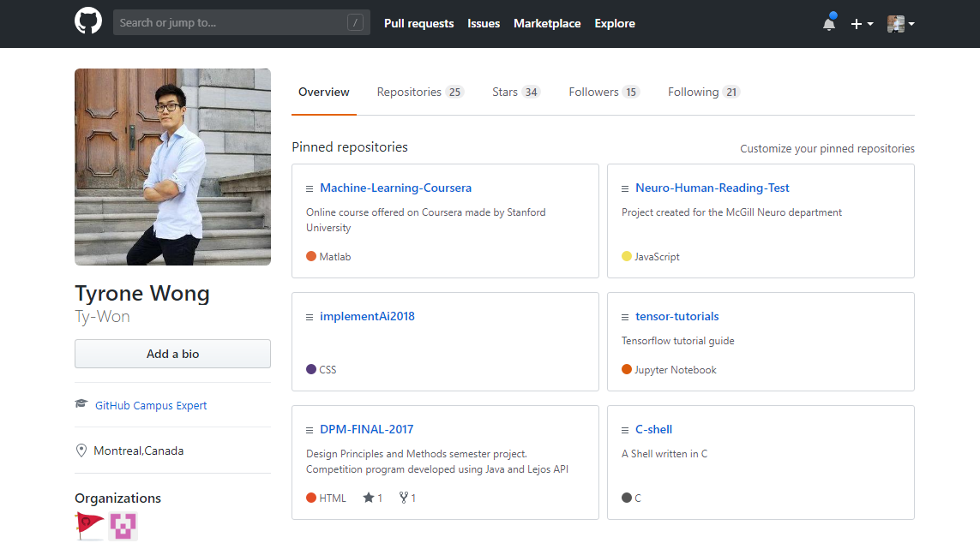
Log into GitHub
Let’s create that first repository!

Slide 16

what are commits?
snapshots of the state (e.g. changes in code) of your repository

Slide 17
Let’s take a look!
$ git log
This command allows you to see all the commit history

Slide 18
commits
Bc7fd9 “Add oranges”
a3ffde “Add apples”
9cd1ce “First commit, Add fruit.txt”

Slide 19
Let’s make a commit!
Make or change a file within your project, save it and perform
$ git status
What do you see?

Slide 20
Commit your own work by using
$ git add <Files or directory>
$ git commit -m “<details>”

Slide 21
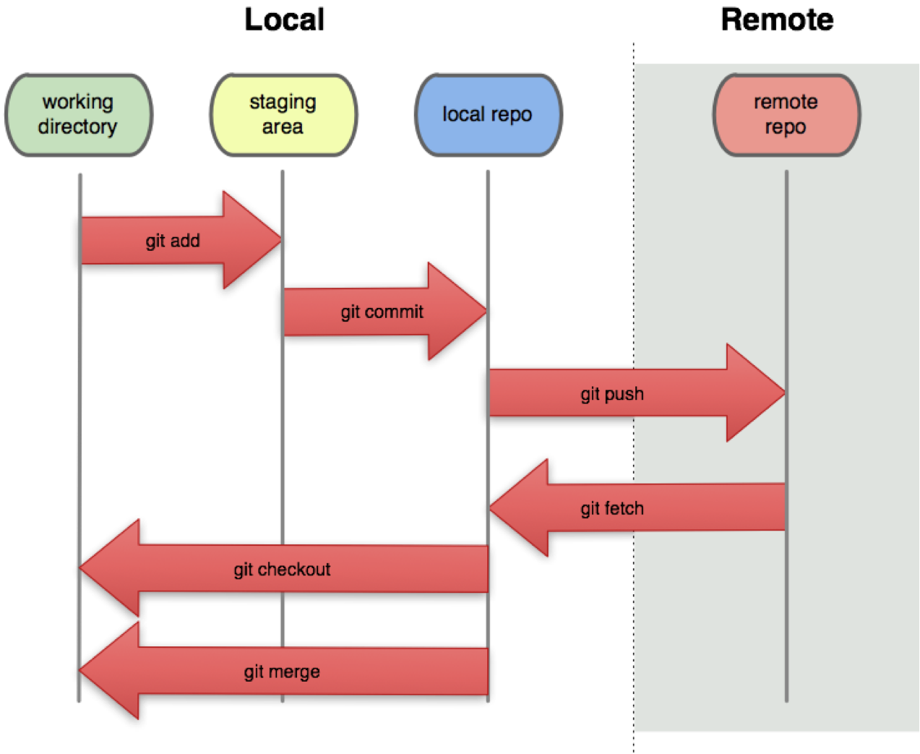

Slide 22
To reset your commits
$ git reset <file or head>
Can be used to unstage files, commits or reset files

Slide 23
my first git: recap
$ git init - converts a folder to a super smart git repository
$ git status - show useful information about the repository
$ git log - see the history of commits
$ git add <files> - adds the files you want to be tracked to the staging area.
$ git commit -m”<message here>”- creates a new snapshot of your repository at that point in time.

Slide 24
my first git: recap
$ git reset HEAD - unstage your files and reset commits depending on the type of reset
i.e) git reset <--hard or --soft or --mixed)>
The --hard tag will reset code and commits,
The --soft will reset commit but keep code and leave it in staging
The --mixed will reset commit and keep code in in working directory (the default if no tag is specified)

Slide 25
Let me ask you some questions first.
Do you have any kind of coding project?
( It might just be a simple java / c program. )
Now, If someone asks you to share your code, how will you do it?

Slide 26

Here’s your solution:
GitHub let’s you
host all your project files on a remote repository!

Slide 27
git good
Working with GitHub and Git Fundamentals 101

Slide 28
Coming back to this

Slide 29
downloading / updating Repos
$ git clone <url> - downloads a copy of a remote git repository.
$ git pull - Grabs new changes from the remote repository and adds them to your local copy
$ git push - sends your version to the remote repository

Slide 30

Collab
Branching, Issues and Backlogs

Slide 31

working with branches
Branches allows you to have your own version of the code and make changes without affecting anyone else!
$ git branch
Allows you to see all branches

Slide 32
commits
branches
Bc7fd9 “Add oranges”
master
a3ffde
“Add apples”
9cd1ce “First commit, Add fruit.txt”

Slide 33
Let’s create our own branch
.
$ git branch <branchname>
This command branches off from the last commit you were working off

Slide 34
commits
branches
HEAD
Bc7fd9 “Add oranges”
master
HEAD
somebranch
a3ffde
“Add apples”
9cd1ce “First commit, Add fruit.txt”

Slide 35

working with HEAD
$ git checkout <branch name> - Redirect HEAD to the desired branch

Slide 36
commits
branches
HEAD
Bc7fd9 “Add oranges”
master
somebranch
HEAD
a3ffde
“Add apples”
9cd1ce “First commit, Add fruit.txt”

Slide 37
merging = combining commits
$ git merge <branch name> - combines the last commit of the current HEAD branch with the last commit of the branch specified.

Slide 38
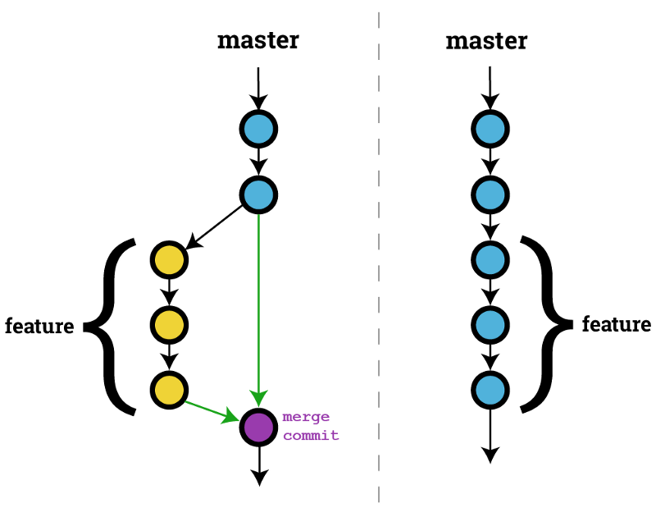
merging = combining commits

Slide 39
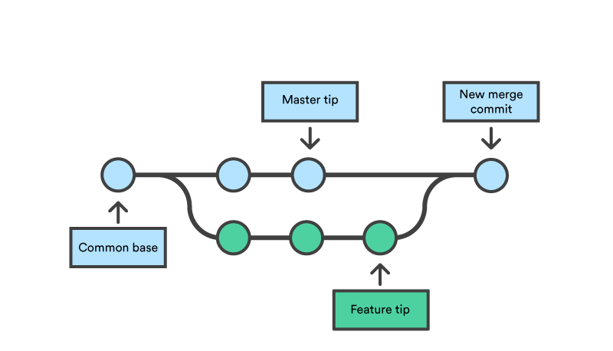
Potential issues

Slide 40
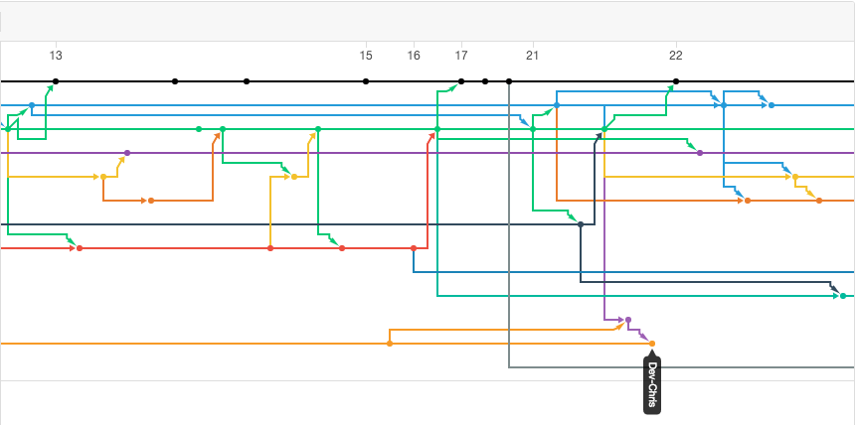
Sometimes things can get messy

Slide 41
git good: recap...
$ git branch - List all branches
$ git branch <name> - creates a branch with that name
$ git checkout <name> - jump to the branch with this name
$ git merge <name> - merge the branch specified by name into the current one you are working on

Slide 42
Let’s, see what we can do with GitHub?
Notes:
Issues
Backlog
Editing + uploading
Starring, following

Slide 43




programs and technology leadership at your school
and much more…
Notes:
Change the links to headings…
https://github.com/campus-experts
https://education.github.com/
https://education.github.com/pack
https://github.com/collections/software-in-science
https://github.com/chrislgarry/Apollo-11

Slide 44
#OpenSourcing
Understand more about the movement that is changing the way you collaborate.

Slide 45






Communities on
open and explore communities that do a change in the open source world.
and many others ...
and much more...

Slide 46



Events on
open and participate in events that happens around the world in prol of the open source.
24 Pull Requests
Hacktoberfest
GitHub Field Day
and much more...

Slide 47


Slide 48
What is Hacktoberfest? 🤔
Celebration of open-source 🎉
All of October 🎃
Beer not included 🍺
Submit PRs -> Get free stuff! 👕
Signup: https://do.co/2RMnc4L ✅

Slide 49
Why?
Learn something new 🎓
Meaningful contributions 💯
Get used to the code reviews 👩‍💻

Slide 50
The anatomy of a Pull Request (PR)
Find a problem to solve
Submit an issue
Read the docs!
Fork and clone
Make changes
Submit Pull Request
Wait for Reviews

Slide 51
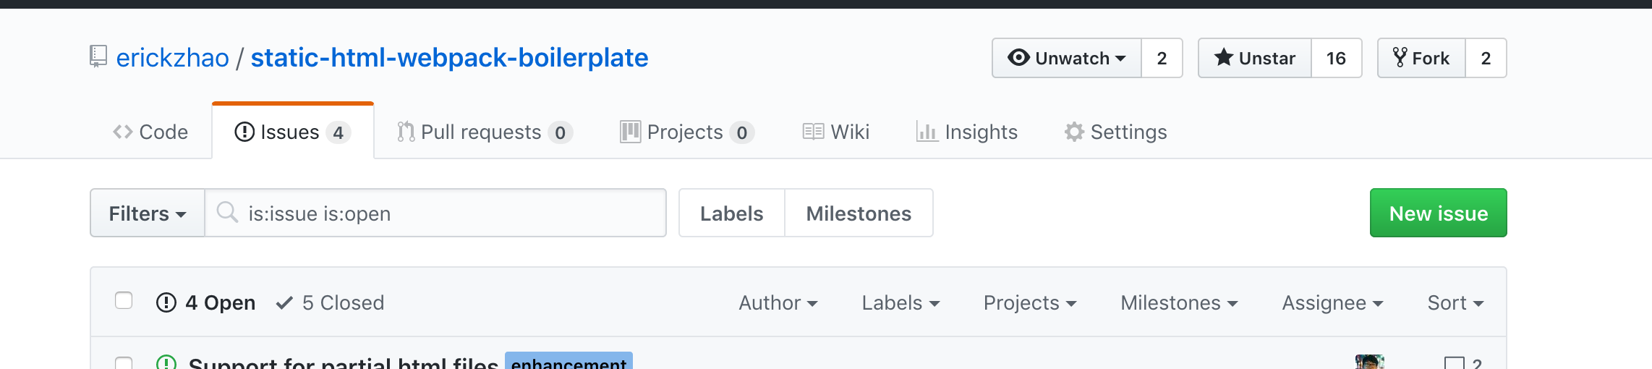

Slide 52
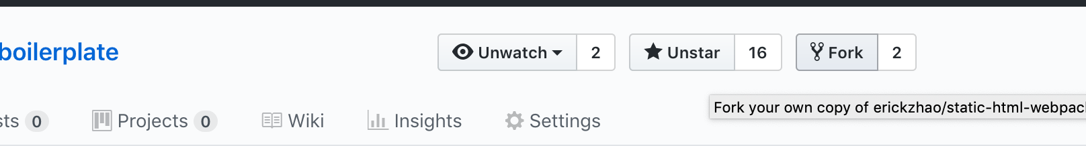

Slide 53
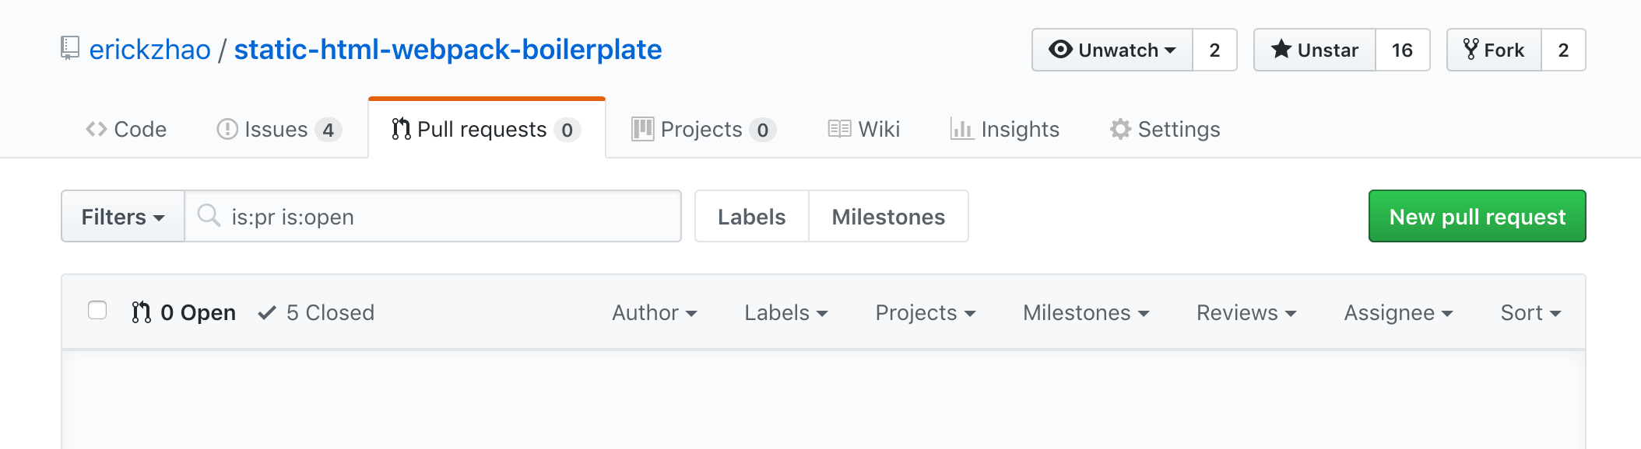

Slide 54
Demo
https://bit.ly/2QVhUTg

Slide 55
What now?
Learn more: https://hacktoberfest.digitalocean.com/
See first-timer friendly projects: https://up-for-grabs.net/#/
Browse issues tagged Hacktoberfest https://bit.ly/2i8dOHG

Slide 56
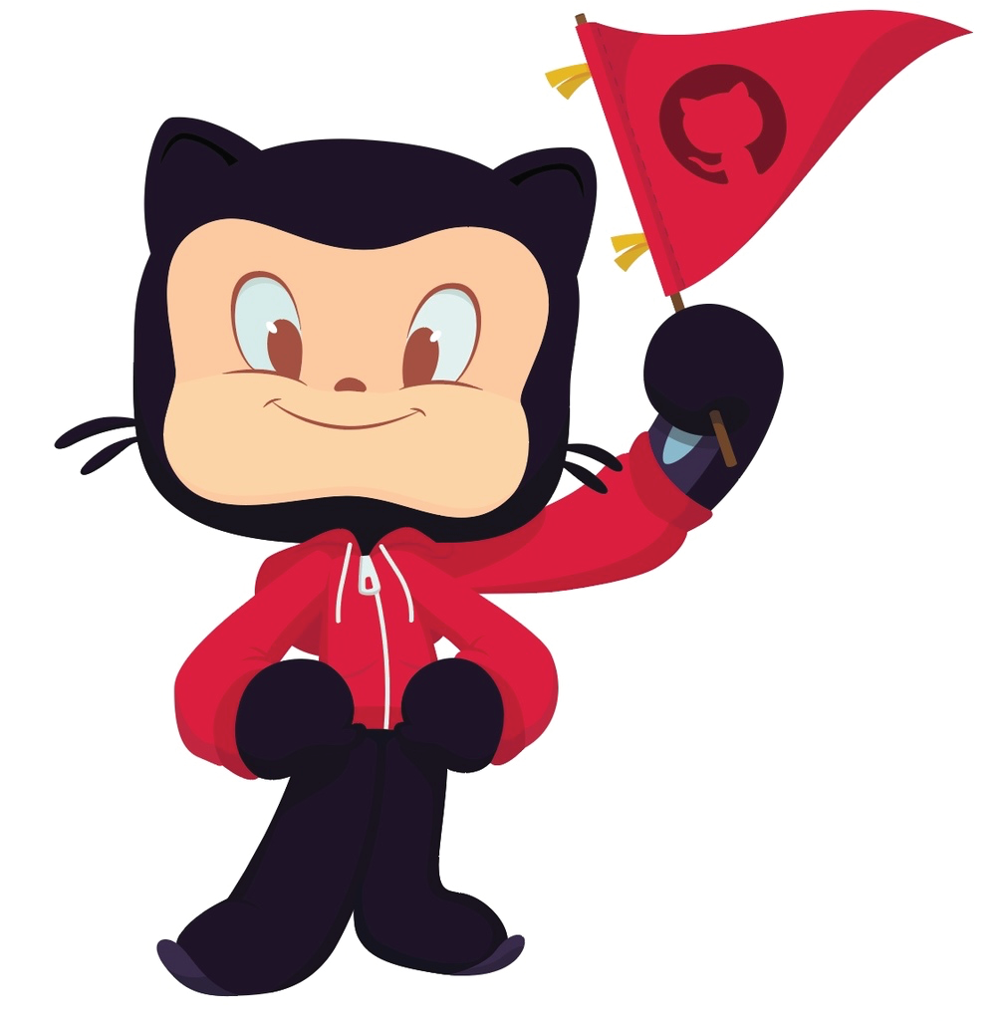
Doubts? Suggestions? Feedback?
Let me know what I can improve on and what else you would like to see!

